Slide 1
HIV LECTURE
BY
DANIEL KIMWETICH
Y3S1
CLINICAL MEDICINE
KMTC NYERI CAMPUS
04/02/2021

Slide 2
MODULE 1:
HIV INFORMATION

Slide 3
Broad objective
To provide information and knowledge of HIV infection

Slide 4
Enabling objectives:
Describe the epidemiology of HIV in Adults and Children
Describe basics of human immune system.
Describe biology and Natural progression of HIV in Adults and Children
Describe classification ARVs, when to initiate and how to monitor treatment
Describe common HIV related conditions and their management.
Describe HIV prevention strategy including stigma reduction.

Slide 5
Contents
Overview and Epidemiology of HIV
Human Immunology & Biology of HIV
Natural progression of HIV-adults and children
Antiretroviral drugs, Initiation and monitoring of ART
HIV related conditions (OP)
6 Prevention strategies

Slide 6
UNIT 1: Overview and Epidemiology of HIV
Objective
To be able to describe the Epidemiology of HIV infection on global, regional and country levels.

Slide 7
Definitions
HIV stands for Human Immunodeficiency Virus. It is a Retrovirus.
HIV Infection is the state where the virus is in the body. In most instances this is the asymptomatic state, which is a prelude to AIDS
AIDS stands for Acquired Immune Deficiency Syndrome.
“Acquired” means it is transmissible, and
“Immune-Deficiency” means it damages the body defense system
“Syndrome” refers to a group of illnesses

Slide 8
Historical Background of HIV
1981 – Doctors in the United States recognized Pneumocystis Carinii (Jirivecii) Pneumonia (PCP) [now referred to as Pneumocystis Jirovecii Pneumonia] in homosexual males, a condition previously unreported in healthy adults. Later they recognized that all these patients were immunosuppressed.
1983/4 – Scientists described the cause of this acquired immunodeficiency syndrome (AIDS) as a retrovirus:
Lymphadenopathy Associated Virus (LAV).
AIDs Associated Retrovirus (ARV).
Human T-lymphotrophic Virus (HTLV).

Slide 9
Historical Background of HIV cont…..
1984– The first case in Kenya was described
1986 – Human Immunodeficiency Virus (HIV) was accepted as the international designation for the retrovirus in a WHO consultative meeting
1996 – ARVs became available in the world.
1997 – ARVs became available in the private sector in Kenya.
2003 – ARVs became available in public sector in Kenya.
2006 – Approximately 90,000 Kenyans were on ARV treatment.

Slide 10
Epidemic update Global update
Estimated 40 million living with HIV by end of 2004
Fourth biggest killer in the world
About one-third of PLHA are between 15-24 years
Most people are still unaware they are infected
Young women are more vulnerable

Slide 11
Adults And Children Estimated To Be Living With HIV As Of End 2004
Western & Central Europe
610 000
[480 000 – 760 000]
Eastern Europe & Central Asia
1.4 million
[920 000 – 2.1 million]
North America
1.0 million
[540 000 – 1.6 million]
East Asia
1.1 million
[560 000 – 1.8 million]
Caribbean
440 000
[270 000 – 780 000]
North Africa & Middle East
540 000
[230 000 – 1.5 million]
South & South-East Asia
7.1 million
[4.4 – 10.6 million]
Sub-Saharan Africa
25.4 million
[23.4 – 28.4 million]
Latin America
1.7 million
[1.3 – 2.2 million]
Oceania
35 000
[25 000 – 48 000]
Total: 39.4 (35.9 – 44.3) million
Source: UNAIDS 2004 Report on the Global AIDS Epidemic

Slide 12
Children (<15 years) estimated to be living with HIV as of end 2005
Western & Central Europe
5 300
[4 200 – 6 800]
Eastern Europe
& Central Asia
7 800
[5 300 – 14 000]
North America
9 000
[4 600 – 14 200]
East Asia
5 000
[1 900 – 14 000]
Caribbean
17 000
[9 900 – 34 000]
North Africa & Middle East
37 000
[12 000 – 130 000]
South
& South-East Asia
130 000
[73 000 – 250 000]
Sub-Saharan Africa
2.1 million
[1.8 – 2.5 million]
Latin America
50 000
[35 000 – 91 000]
Oceania
3 300
[1 000 - 13 000]
Total: 2.3 (2.1 – 2.8) million

Slide 13
Epidemic Update: Sub-Saharan Africa
HIV is now the leading cause of death
25.0 – 28.2 million living with HIV infection by end of 2003
10-15% of them need ARV
Estimated 3-3.4 million new HIV infections in 2003
70% found in sub Saharan Africa
10% (600 million) of world’s population live in sub Saharan African
By 2010, an estimated 106 million children under age 15 will have lost one or both parents, with 25 million of this group orphaned due to HIV/AIDS

Slide 14
Epidemic update: Kenya
Indicator | NASCOP 2011
National adult prevalence: 15 - 49 years | 6.3% Women-8% Men 4.5%
Total Number of HIV infected people | 1.5 Million
Prevalence in rural areas NB. 75% of people live in rural areas | 6.4%
Prevalence in urban areas | 8.4%
Number of children orphaned by the scourge | 1.2 million

Slide 15
Indicator | NASCOP 2011
Number of people who died of Aids related complications in 2009 | 80, 000
Number of people aged 15 years and above who have undergone HIV testing and counseling | <4.4 million
Percentage of people who have been tested at least once | Women – 73.5% Men – 58.6%
Many people are still not being reached by HIV prevention and treatment | Under half in adults are reached - 1:3 children are reached

Slide 16
Epidemiology/Impact of HIV/AIDS in Kenya
60% medical beds- HIV/AIDS
40% Paediatric beds-HIV/AIDS
>50% TB patients – HIV +
>25% STI patients – HIV+
Health workers face both the medical and social challenges of HIV/AIDS on a daily basis

Slide 17
MODES OF TRANSMISSION
Transmission route | %
Sexual intercourse | 70-80
Mother-to-child-transmission | 5-10
Blood transfusion | 3-5
Injecting drug use | 5-10
Health care – e.g.: needle stick injury | <0.01

Slide 18
SUMMARY
Over the past 2 decades HIV has spread worldwide with devastating epidemiological consequences particularly in Sub Saharan Africa
MTCT is the main mode of transmission of HIV infection to children
HIV/AIDS is a major cause of morbidity and mortality

Slide 19
Unit 2: Human Immunology & Biology Of HIV
Objectives
Define the cells involved in the immune system and their function.
Know the host immune response during and after infection.
Basic HIV structure.
The significance of genetic diversity and classification of HIV.
The replication cycle of HIV.
The target sites for antiretroviral drugs

Slide 20
Components of the Immune System
Found in blood and tissues
White blood cells (WBC)- key players in immune response (humoral and cellular)
Macrophages act as clearing cells
Neutrophils attack bacteria
Eosinophils attack helminths (and mediate allergies)
B-lymphocytes make antibodies
T-lymphocytes
Responsible for attacking viruses, fungi and some bacteria
T helper cells central in orchestrating function of other immune cells
T killer cells are able to destroy infected cells

Slide 21
How HIV affects the Immune System
HIV attaches to cells of the immune system with special surface markers called CD4 receptors
Immune cells with CD4 receptors include:
T-helper Lymphocytes
Macrophages
Monocytes
Dendritic cells – in nerves
Microglial cells – in CNS

Slide 22
HIV effect on Immune System
The hallmark of HIV/AIDS is profound immunodeficiency as a result depletion of CD4+ T lymphocytes.
The CD4+ T cell dysfunction is two fold
Reduction in numbers
Impairment in function

Slide 23
The Biology Of The Human Immunodeficiency Virus
Basic Virology:
There are two types of HIV. (HIV I and HIV 2)
HIV – 1
Is found worldwide
Is the main cause of the worldwide pandemic
More frequent
Produce a more severe disease
More readily transmitted from mother to child.
92.5% of infection of HIV.
Phylogenetic groups;
i. Group M (11 subtypes A-K)
ii. Group O (9 subtypes)
iii. Group N (New virus)

Slide 24
HIV – 2
Is mainly found in West Africa, Mozambique and Angola.
Causes a similar illness to HIV – 1
Less efficiently transmissible rarely causing vertical transmission i.e. less rapidly transmitted from mother to child
less aggressive
produce milder disease
slower in progress
2.3% of infections by HIV
Subtypes -5- A to E
C is commonly seen in India.

Slide 25
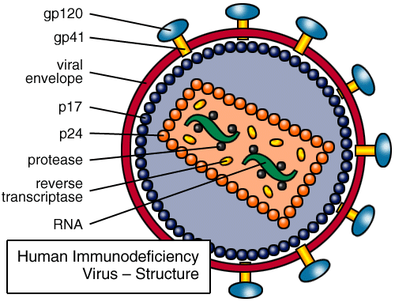
Structure Of Human Immunodeficiency Virus
Has an outer double lipid membrane, (derived from the host membrane).
The lipid membrane is lined by a matrix protein.
The lipid membrane is studded with the surface glycoprotein (gp) 120 and the transmembrane gp 41 protein.
These glycoprotein spikes surround the cone-shaped protein core.

Slide 27
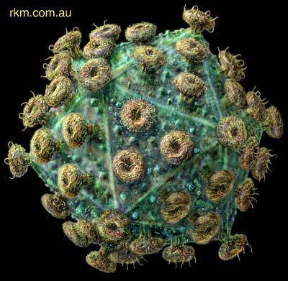

Slide 28
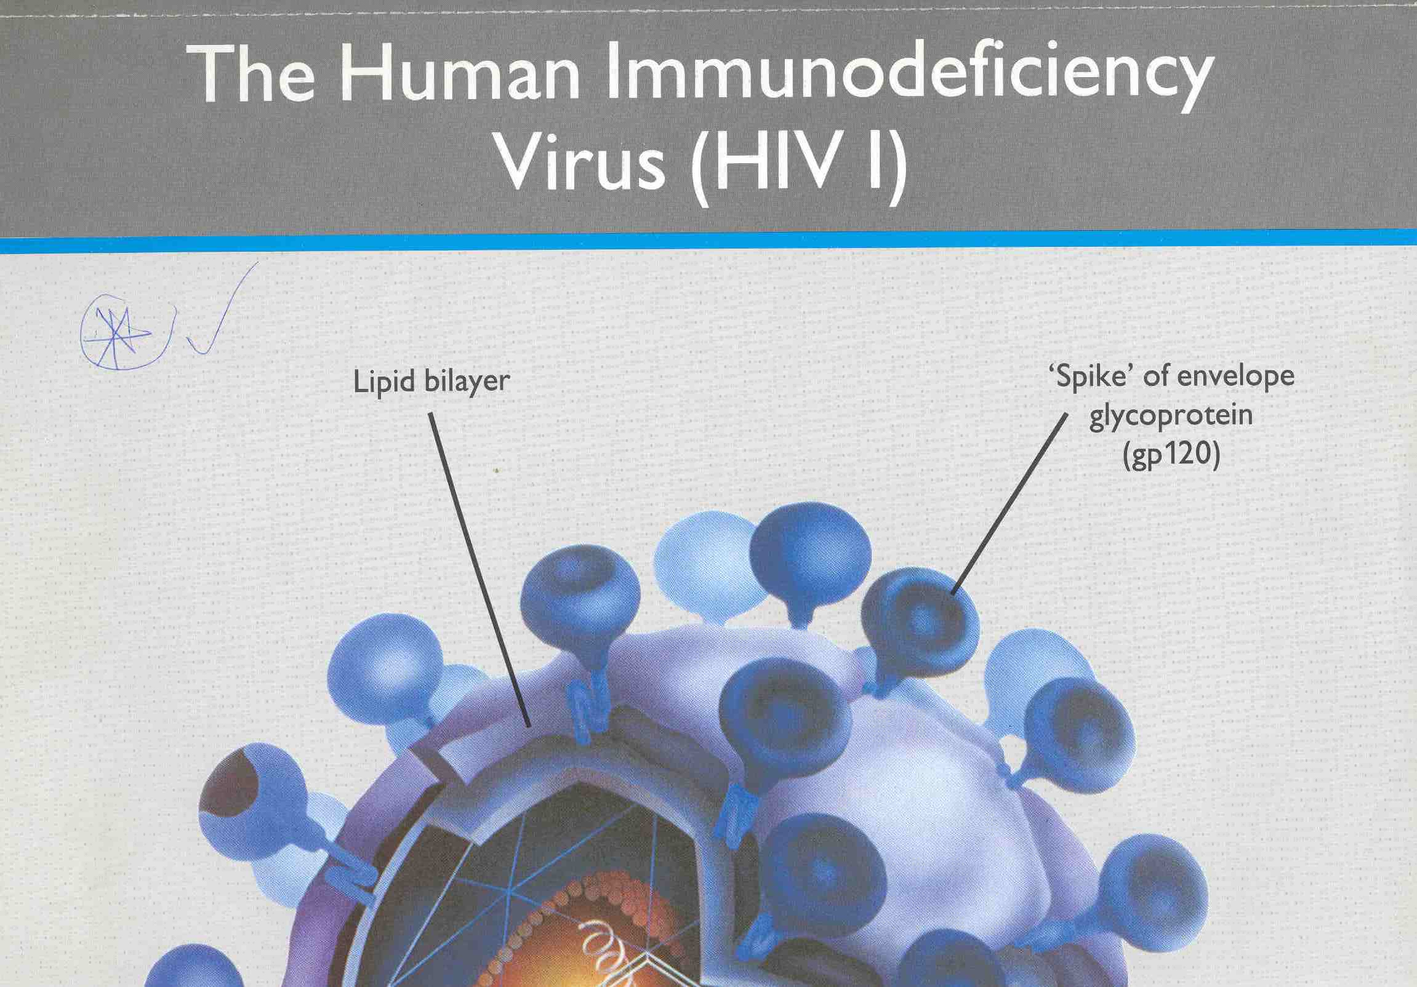
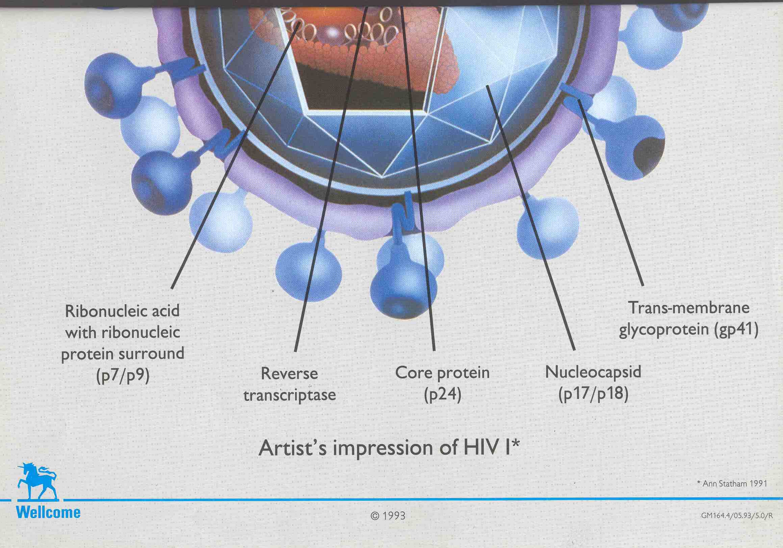

Slide 29
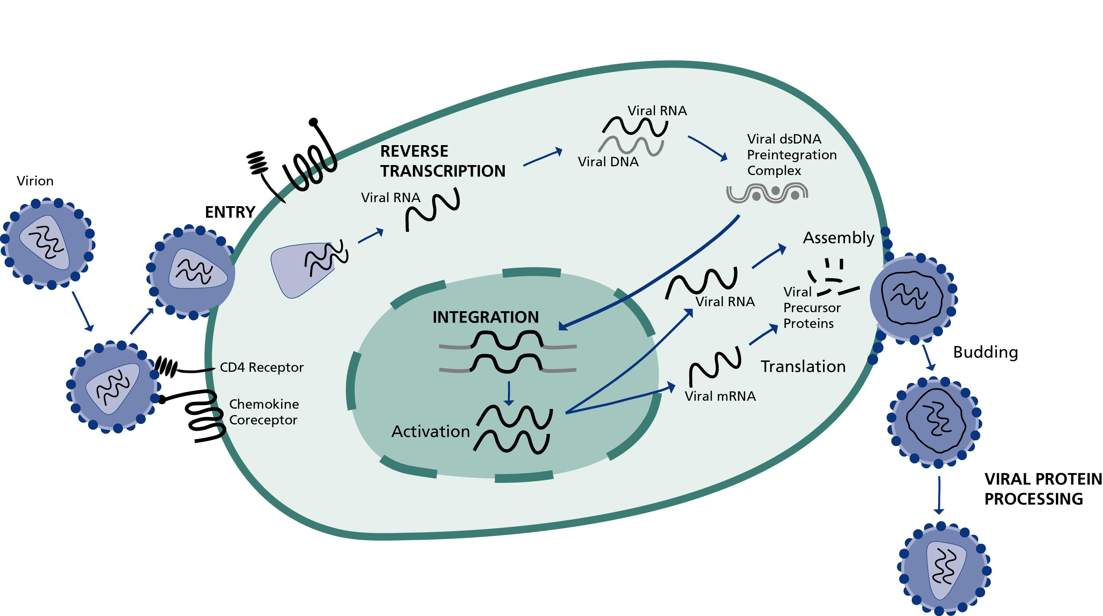
HIV Life Cycle
Binding, Fusion and Entry
Transcription
Integration & Replication
Budding
Maturation

Slide 31
Binding
Glycoprotein GP 120 binds to the host cell surface receptor (CD4 molecule) and Co-receptor (CCR5/CXCR4) for successful entry.
Can also bind to CXCR2, CXR3, and can hitch on B-cells to Lymph nodes.

Slide 32
Fusion
Viral binding to host cell triggers fusion of the viral and host cell membrane.

Slide 33
Entry
This is mediated by gp41
gp41 allows entry of virus core into host cell cytoplasm.
Core protein then is dissolved by host enzymes releasing viral RNA and enzymes.

Slide 34
Transcription
Reverse transcriptase converts the viral RNA into a single strand of DNA.
RT also acts as a DNA polymerase to produce a partner strand of DNA to match the original template resulting in a double stranded DNA.
The dsDNA enters the host cell nucleus

Slide 35
Integration
Integrase catalyses the process of integration of viral DNA into the host cell’s DNA to form a PROVIRUS

Slide 36
Replication
Integrated viral DNA turns the host cell into a factory for manufacturing more virus.
This is done by directing the viral messenger RNA (mRNA)
mRNA leaves the nucleus and enters the cytoplasm (ER) where it produces viral proteins (core, envelope, and regulatory proteins and enzymes) essential for HIV replication.

Slide 37
Budding
Viral proteins together with genomic RNA gather at CD4+ cells membrane
It is then cleaved by protease enzyme and assembled to form immature viruses.
Immature viruses bud off the cell and enter the blood stream.

Slide 38
Maturation
Newly assembled virons undergo polypeptide cleavage to form mature virus (protease – p160)
CD4 cells are often destroyed by HIV viral replication resulting in profound immunodeficiency.

Slide 39
NB
Average HIV-1 production is 10.3x10⁹ virions per day
High rate of reproduction results in mistakes in genetic transcription resulting in the high genetic diversity of the virus. Approximately 1-2 mutations per replication cycle.
Productively infected cells have average life-span of 2.2 days
Average HIV-1 generation time is 2.6 days (140 generations/yr) [Time from release of a virion until it infects another cell and cause the release of a new generation of viral particles]
Each infected cell produces on average 250 new virions before it fails and dies.

Slide 40
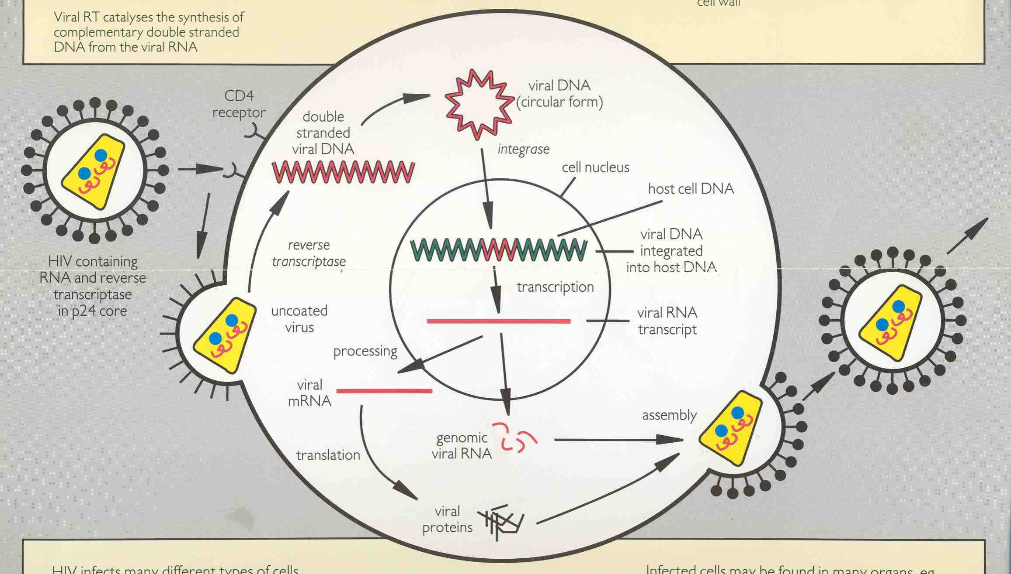
REPLICATION PROCESS

Slide 41
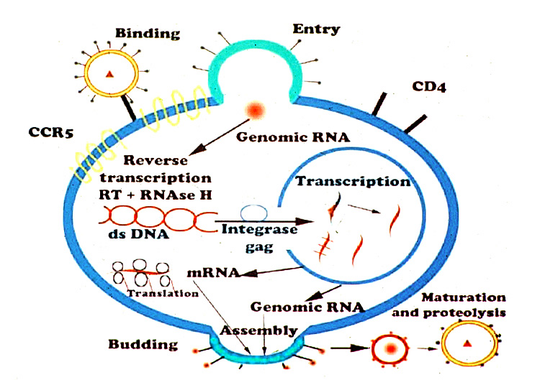

Slide 42
HIV Entry Mechanism
HIV
2. Co-receptor
interaction
HIV
HIV
gp41
3a. Anchorage
gp120
HIV
1. CD4
Attachment
CXCR4
CCR5
CD4
gp41
Cell
3c. Fusion
Complete
HIV
3b. coil-coil
interaction
HIV

Slide 43
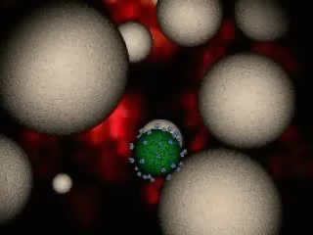
HIV LIFE CYCLE MOVIE CLIP

Slide 44

Pficer recording of HIV cycle clip

Slide 45
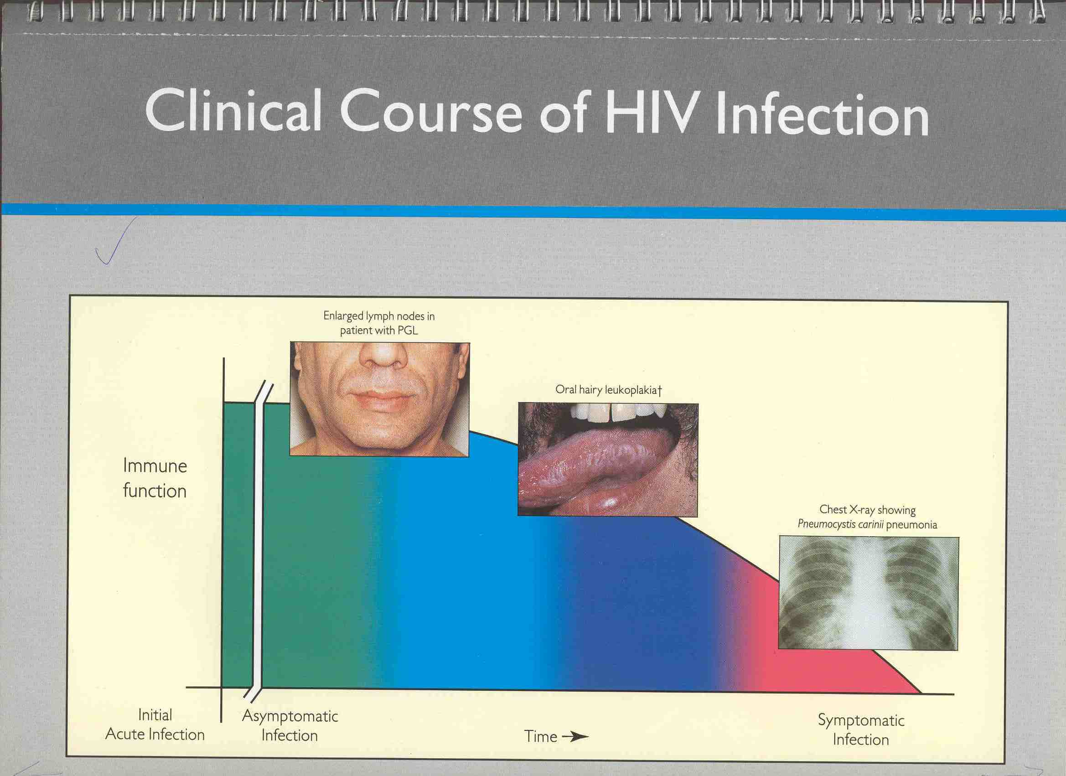

Slide 46
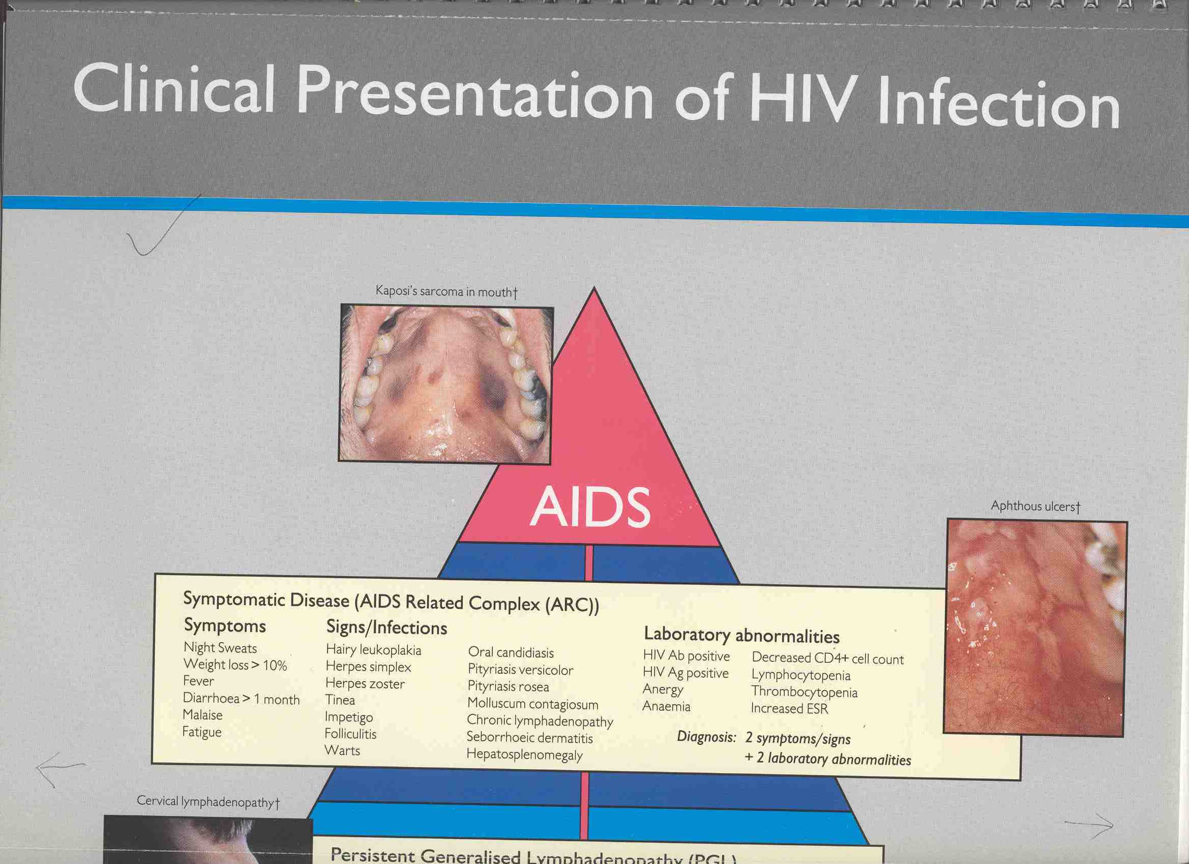

Slide 47
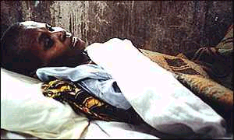
Acquired Immune Deficiency Syndrome
AIDS represents the end-stage disease that results from untreated HIV infection.

Slide 48
SUMMARY
HIV attacks the Immune system of human being and leads to profound immunodeficiency.
Rapid replication of HIV causes genetic diversity of the virus.
Knowledge of the HIV structure is important in understanding the mechanism of ARV drugs

Slide 49
HIV Replication Cycle summary
HIV virion binds to CD4 receptor.
Virion and cell membrane coats fuse.
Viral RNA empties in the CD4 cell.
Enzyme transforms viral RNA into DNA.
New virions bud out of cell membrane and are released.
Notes:
Explain – HIV is known as a RETROVIRUS. Unlike most microbes, it is made from RNA instead of DNA. It uses a special enzyme, called REVERSE TRANSCRIPTASE to copy its genetic material backwards - RETRO.

Slide 50
UNIT 3: Natural progression of HIV
Objectives
Describe stages of HIV progression - serocoversion, asymptomatic, symptomatic and AIDS phases
Be able to stage HIV infection by WHO classification

Slide 51
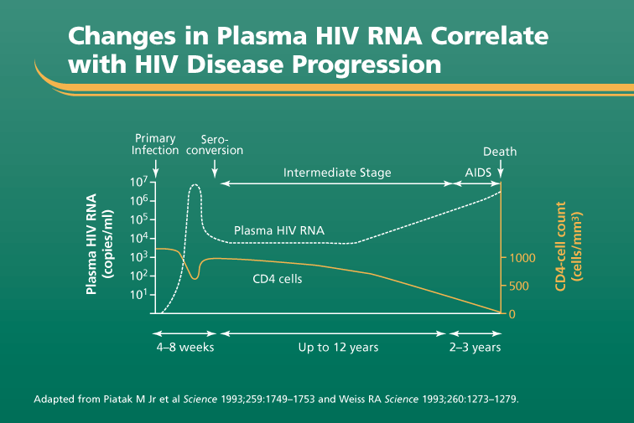

Slide 52
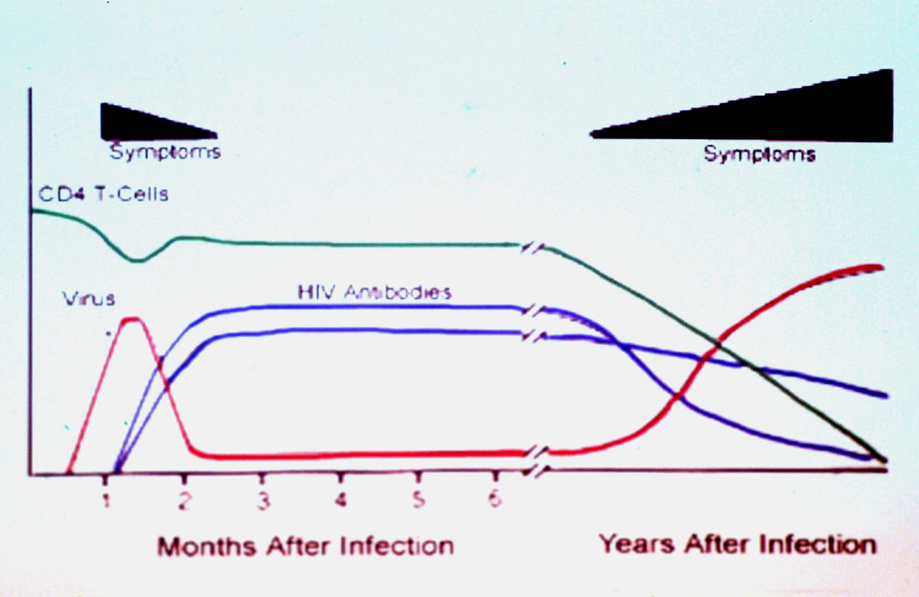

Slide 53
Host immune response during HIV infection
Primary HIV Infection
On exposure, there is a 2-4 week period of intense viral replication and widespread dissemination of virus characterized by
1. High plasma viral load (RNA)
2. Rapid decline in CD4 count
Notes:
The natural history of HIV infection encompasses an acute/primary phase that lasts months, followed by an early/clinically latent phase that typically lasts 3–10 years, and ultimately by the immune collapse characterized by AIDS. Acute” HIV infection best describes the interval during which HIV can be detected in blood serum and plasma before the formation of antibodies routinely used to diagnose infection. During this time, high levels of viremia and shedding at mucosal sites can be demonstrated, because HIV replication is unrestrained by immune responses. Approximately 30 days after infection, early virus-specific immune responses are mounted, with subsequent reduction of viremia. After 4–6 months, viral and host factors combine to determine a new pseudo–steady state of viremia (or virologic “set point”) for each patient, heralding the beginning of the long clinical latency experienced by patients infected by HIV.
Recognition of acute HIV infection is important for several reasons. First, acute HIV provides a unique view of HIV transmission and pathogenesis, including early host-virus interactions that require further study. Second, prevention strategies directed at subjects with acute HIV infection may have great impact. Third, very early recognition may allow for HIV treatment that could alter the natural history of disease, or even eliminate infection.
Despite infection of nearly 60 million individuals worldwide with HIV, fewer than 1,000 cases have been diagnosed in the first month of infection, primarily because of a lack of a specific and recognizable acute retroviral syndrome. About half of people with acute HIV infection develop headache, fever, myalgias, anorexia, rash, and/or diarrhea after an incubation period of around 14 days. Symptoms are generally minor and last days to weeks. Genital or oral ulcers may be present, and co-infections with other sexually transmitted pathogens (e.g., herpes simplex virus, gonorrhea, syphilis, hepatitis viruses) are common. The latter observation suggests common co-transmission of HIV and other sexually transmitted disease (STD) pathogens.
The initial HIV-1–specific immune response is characterized by the appearance of non-neutralizing antibodies detected by ELISA 2–4 weeks after infection. These antibodies serve as the basis for the diagnosis of HIV. However, they have no effect on viral load and appear to exert little selective pressure. Neutralizing antibodies are detected 8 weeks or more after infection, well past the viral-load peak. Neutralizing antibodies seem to place strong immune pressure on the virus, as evidenced by escape variants that appear together with an explosion of viral diversity. While neutralizing antibodies exert strong selective pressure, they do not appear to have a sustained effect on HIV RNA levels in plasma, which demonstrates the ease with which HIV-1 escapes from this immune response. Retrovirus-specific CD8+ CTLs detectable early after infection are strongly associated with control of viremia in acute infection and established infection.
.
Clinical recovery is accompanied by a reduction in plasma viremia,
reflecting development of cytotoxic T-cell (CTL) response

Slide 54
3. In some cases an acute illness occurs
Lasts from 1-2 weeks, but it is rarely diagnosed
Symptoms if present resemble those of other viral illnesses; headache, fever, myalgias, anorexia, rash, and/or diarrhea
Requires high index of suspicion
4. Thereafter there is Symptom resolution with reduction in plasma viremia due to development of an immune response and antibodies to the virus

Slide 55
Asymptomatic Disease (Latency)
Patients then enter a stage of asymptomatic disease phase lasting on average 2-10 years (clinical latency)
Characterized by gradual decline in CD4 count
Rate depends on viral load
Long term non-progressors
Rare
>10-15 year survival without ART
CD4>500; low viral load
Host genetic/immunological or viral factors may be involved
Notes:
Disease acquisition and progression can be affected by genetic variability in the chemokine receptor CCR5 as well as in HLA types. Disease progression may also be associated in mutations in the HIV genome itself.

Slide 56
Symptomatic Disease and AIDS
Viral load continues to rise causing
Increased demands on immune system as production of CD4 cells cannot match destruction
Increased susceptibility to common infections (URTI, pneumonia, skin etc)
Late-stage disease is characterized by a CD4 count <200cells/mm³ and the development of opportunistic infections, selected tumors, wasting, and neurological complications.
Notes:
In an untreated patient, the median survival
after the CD4 count has fallen to <200 cells/mm3 is 3.7 years; the median
CD4 count at the time of the first AIDS-defining complication is 60-70 cells/mm3;
the median survival after an AIDS-defining complication is 1.3 years. Ann Intern Med 1996;124:654

Slide 57
Revised WHO Classification Clinical Stages I & II
Clinical stage | Selected symptoms
Primary HIV Infection | Unrecognized Acute retroviral syndrome Acute febrile illness 2-4 wks post-exposure often with lymphadenopathy and skin manifestations
Stage I | Asymptomatic Persistent generalized lymphadenopathy
Stage II | Moderate unexplained weight loss (<10% of presumed or measured body weight) Recurrent upper respiratory tract infections (sinusitis, bronchitis, otitis media, pharyngitis) Herpes zoster (past or current episodes in last 2 years) Angular cheilitis Recurrent oral ulcerations (2 or more episodes in 6 months) Papular pruritic eruptions; Seborrhoeic dermatitis; Fungal nail infections of fingers

Slide 58
Revised WHO Classification Clinical Stage III
Clinical Stage | Selected symptoms
Stage III | Conditions where a presumptive diagnosis can be made using clinical signs or simple investigations Severe weight loss (>10% presumed or measured body weight) Unexplained chronic diarrhea for > 1 month Unexplained persistent fever (intermittent or constant for > 1month) Oral candidiasis Oral hairy leucoplakia Pulmonary tuberculosis (diagnosed in last 2 years) Severe presumed bacterial infections (e.g. pneumonia, empyema, pyomyositis, bone or joint infection, meningitis, bacteremia ) Acute necrotizing ulcerative stomatitis, gingivitis or periodontitis Conditions where confirmatory diagnostic testing is necessary Unexplained anemia (<8gm/dl), neutropenia (<1,000/mm3) or thrombocytopenia (<30,000/ mm3) for > 1 month
Notes:
[1 TB may occur at any CD4 count, and this must be considered where available. If CD4 is less than 200 it should be considered as a stage 4 event. Diagnosis and treatment of both pulmonary and extrapulmonary TB should be in line with international and national guidelines.
Vulvovaginal candidiasis, chronic (>1 month or poorly responsive to therapy) removed

Slide 59
Revised WHO Classification Clinical Stage IV Selected Symptoms
Conditions where a presumptive diagnosis can be made using clinical signs or simple investigations:
HIV wasting syndrome
Pneumocystis carinii pneumonia (PCP)
Recurrent severe bacterial pneumonia
Cryptococcal meningitis
Toxoplasmosis of the brain
Chronic orolabial, genital or anorectal herpes simplex infection for > 1month
Kaposi’s sarcoma (KS)
HIV encephalopathy
Extrapulmonary tuberculosis
Cryptosporidiosis, with diarrhea >1 month
Isosporiasis
Conditions where confirmatory diagnostic testing is necessary
Candidiasis of the esophagus or airways
Cytomegalovirus (CMV) retinitis or disease of organs (other than liver, spleen, or lymph nodes)
Non-typhoid salmonella septicemia (NTS)
Lymphoma cerebral or B cell NHL
Invasive cervical carcinoma
Visceral Leishmaniasis
Cryptococcosis (extrapulmonary)
Disseminated non tuberculous mycobacterial infection
Progressive multifocal leukoencephalopathy
Any disseminated endemic mycosis (e.g. histoplasmosis)

